Slide 1



On Deciding if We Like the Stock, Too
Team Stonks
Jennifer Randle
Jeriel Minguillan
Paula Lopes
Sanabu Washizuka
UCSD Extension - The Data Science and Visualization Boot Camp
ETL Project

Slide 2
Introduction
-Extract, Transform, Load
-Ny Times API
-Marketing/Business aspect of ETL using NY Times API
-Gamestop
-ETL processes in a production environment
-raw responses
-analysis ready
-Compensating over time
-Data Integrity
-Do we like the stock?

Slide 3
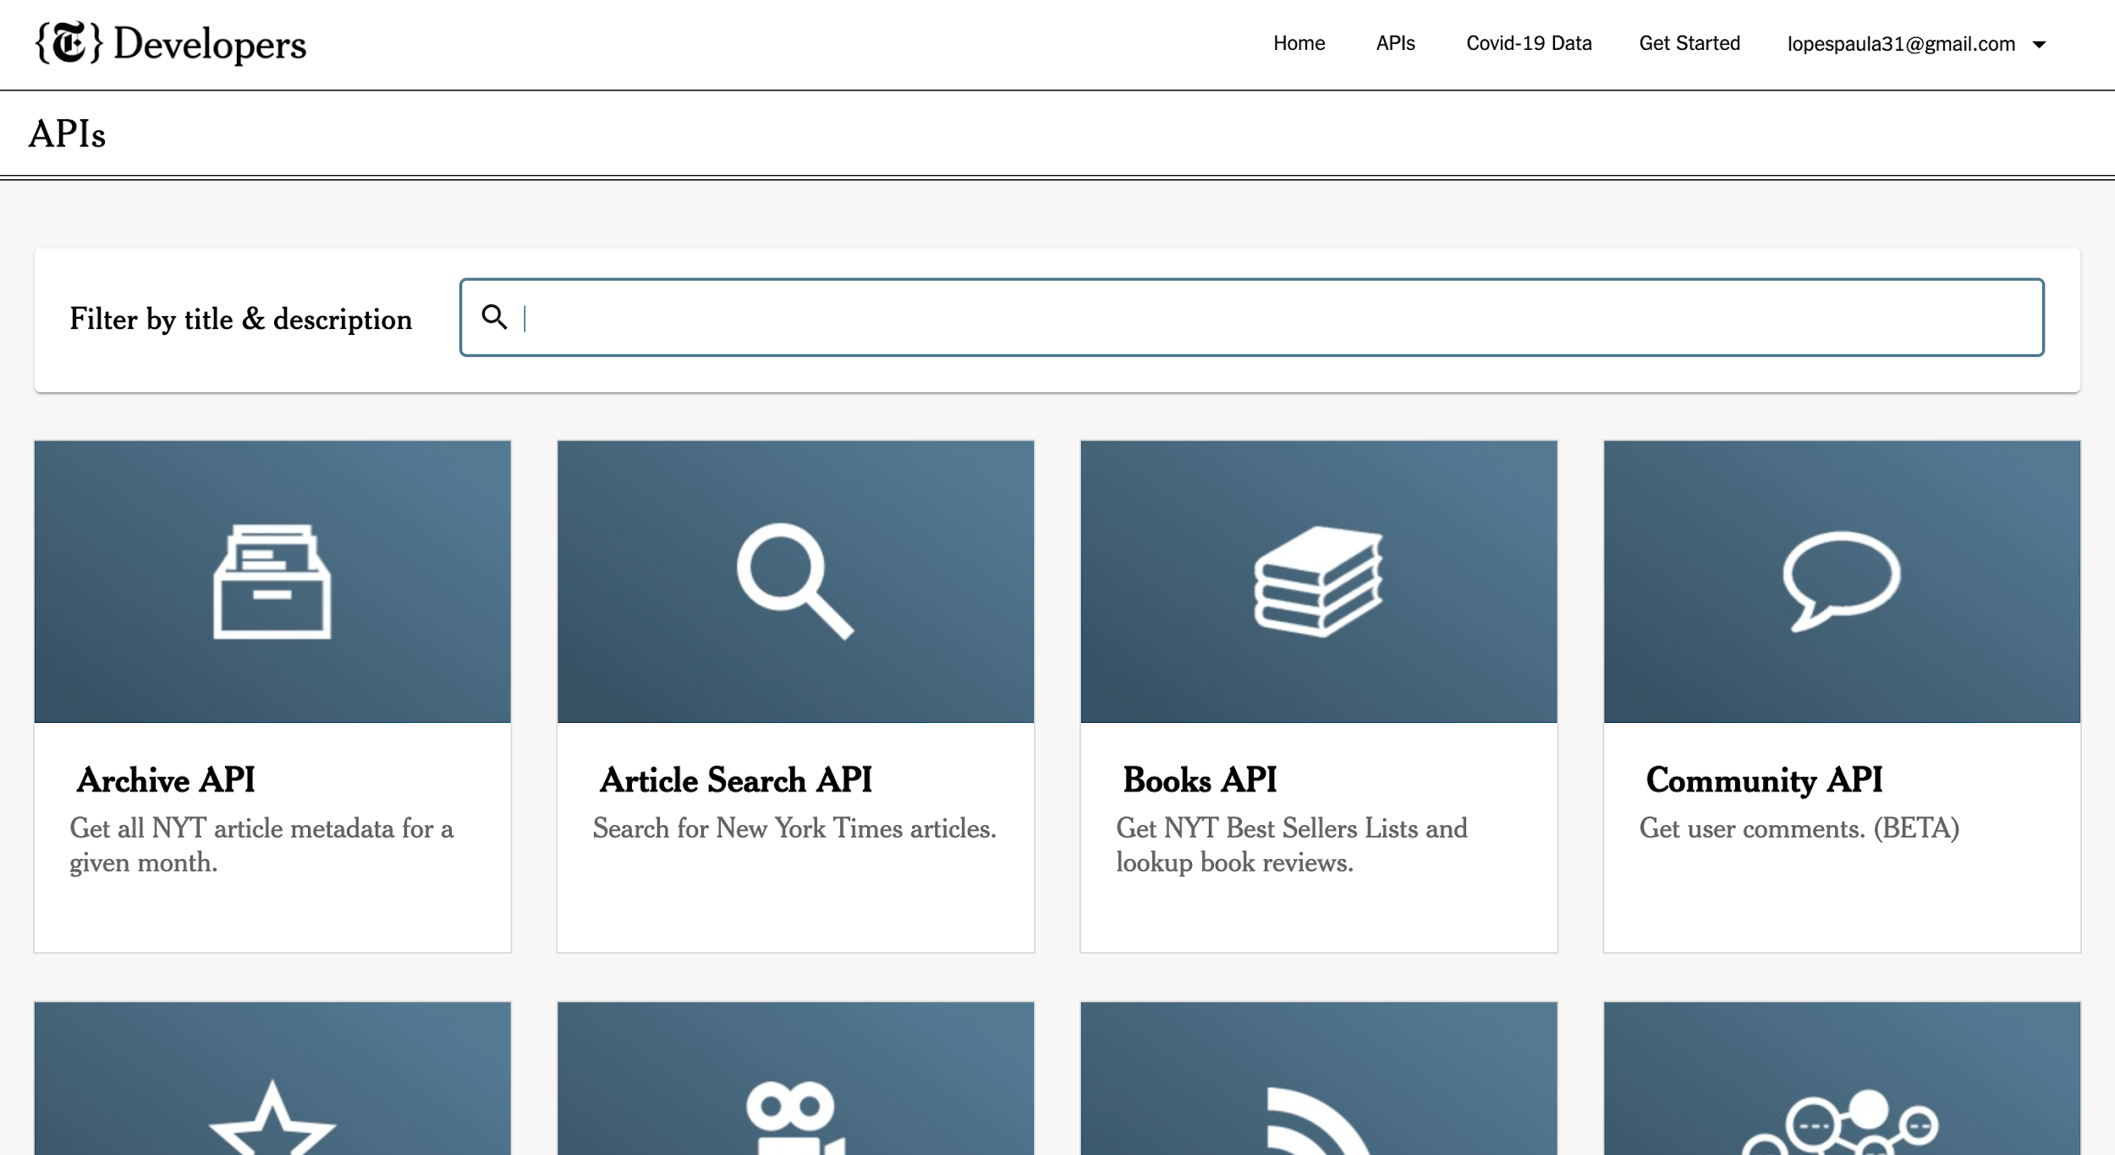
New York Times API’s

Slide 4


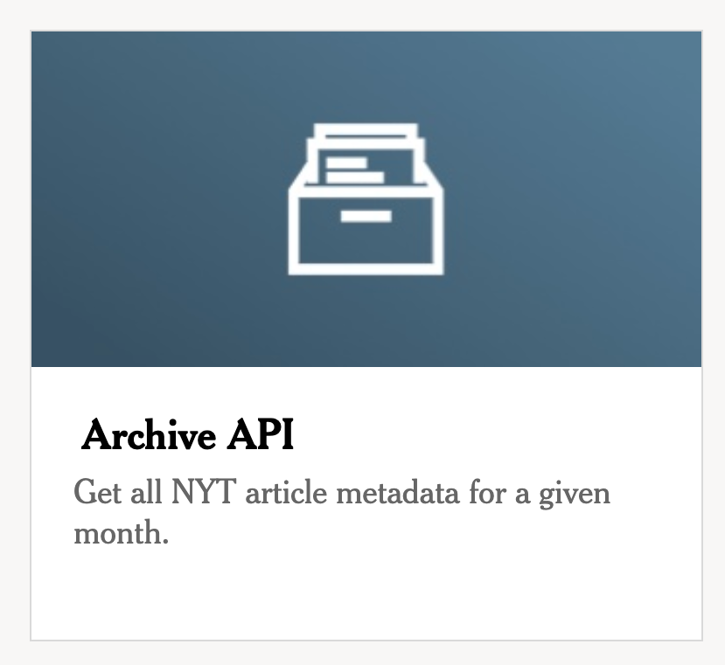


Slide 5
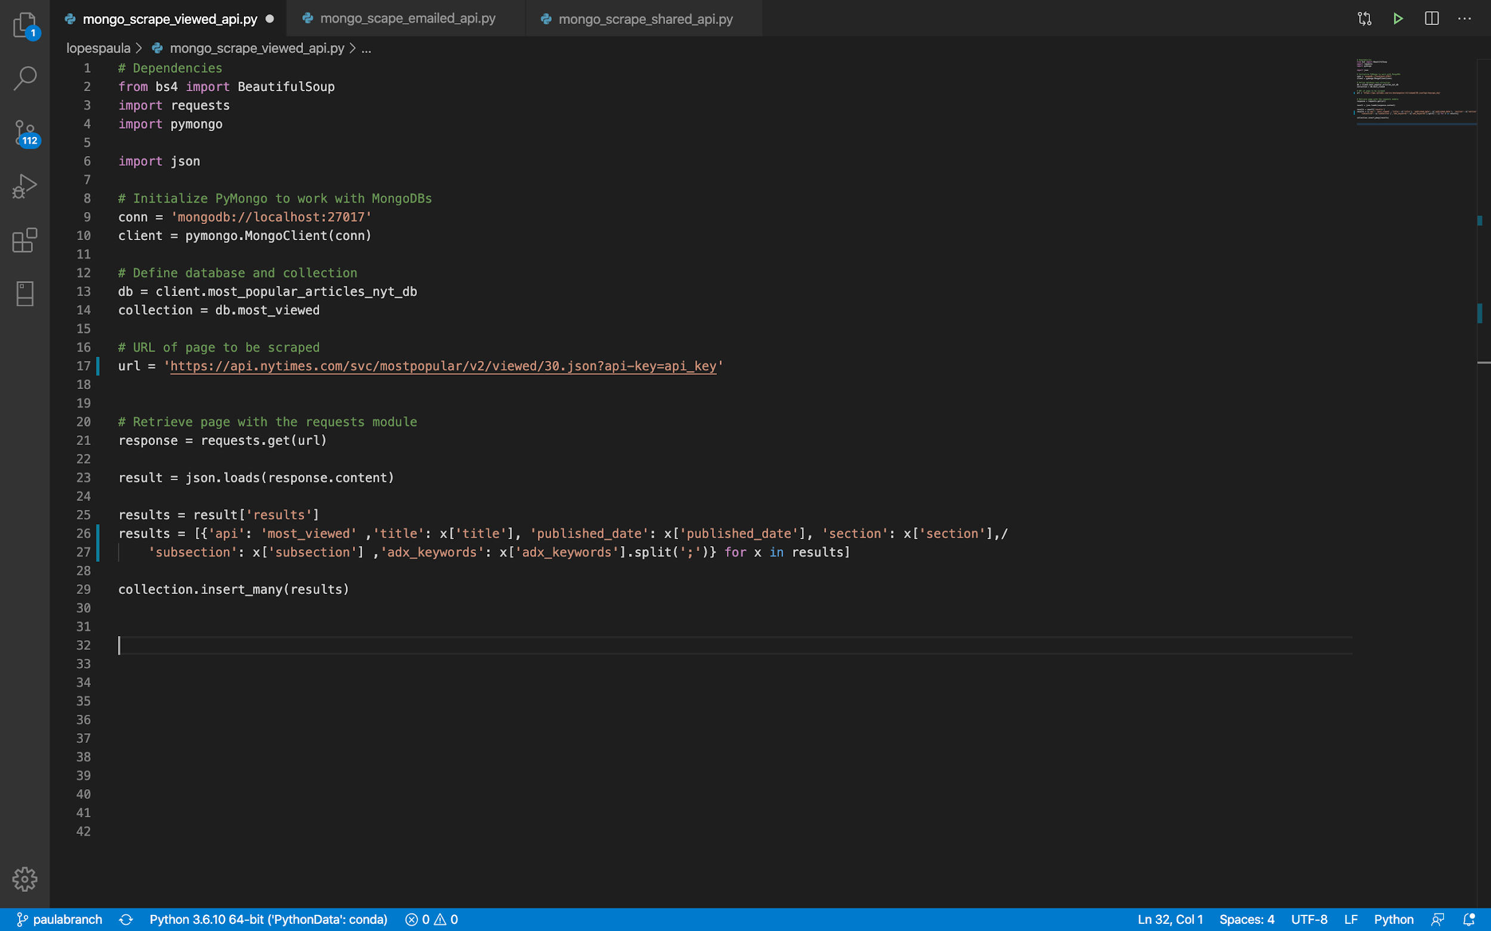
Most Popular API

Slide 6
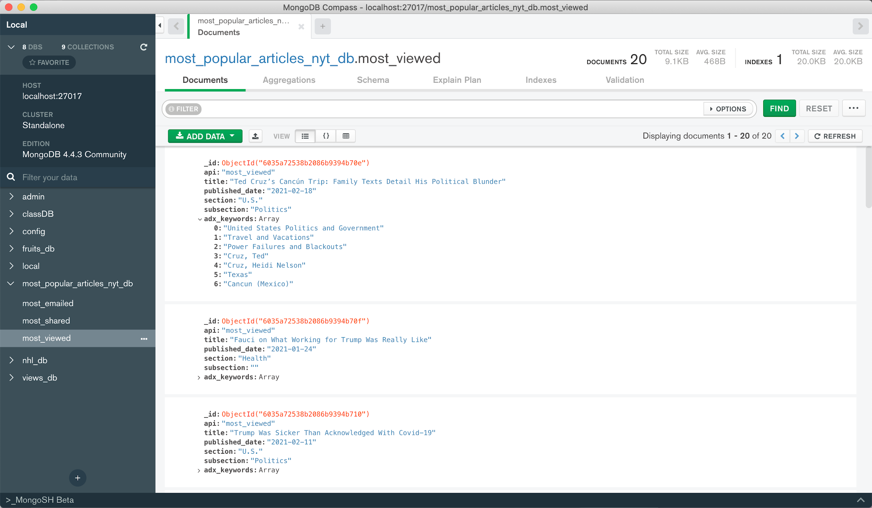

Slide 7
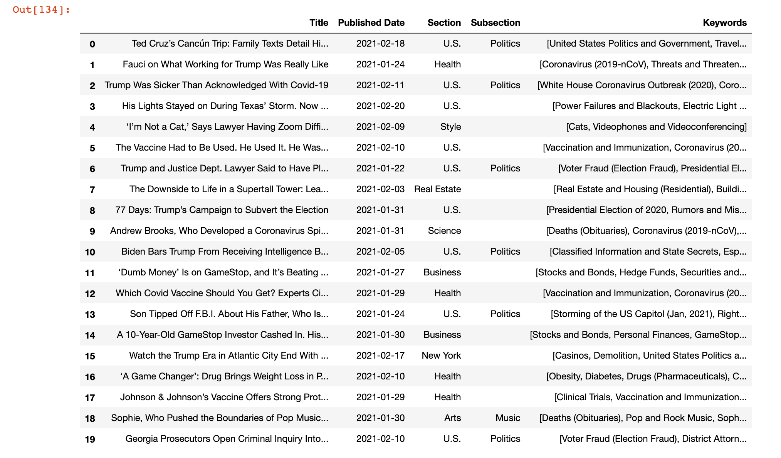
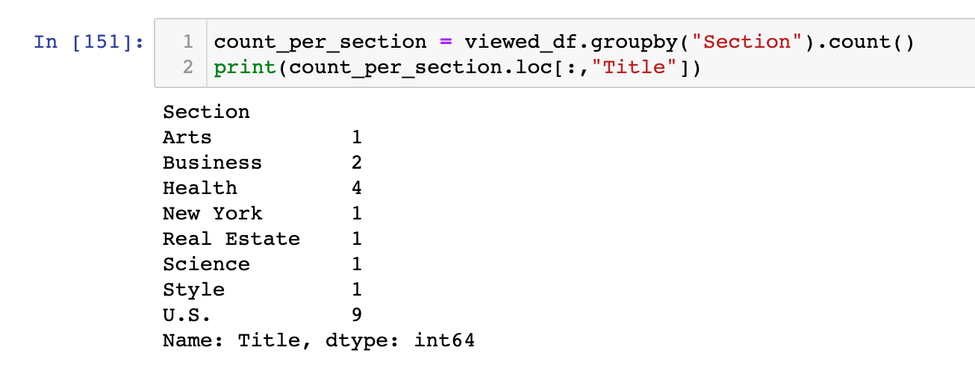

Slide 8
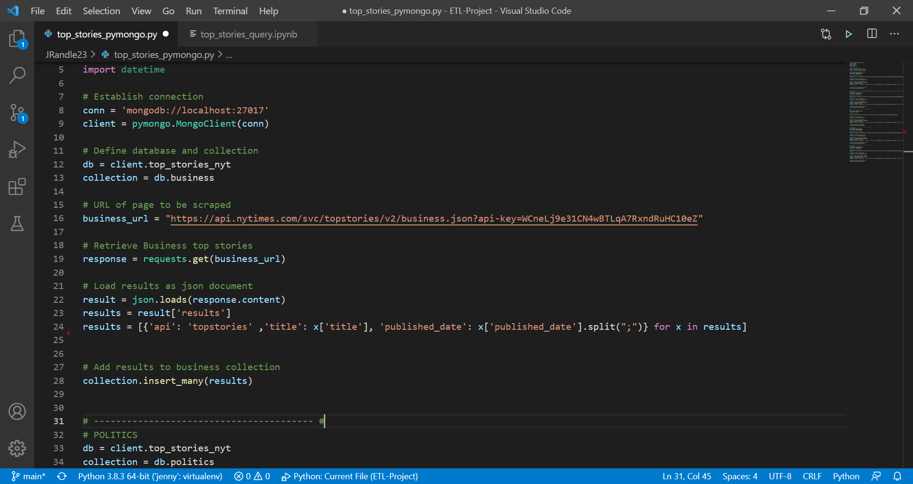
Top Stories API

Slide 9
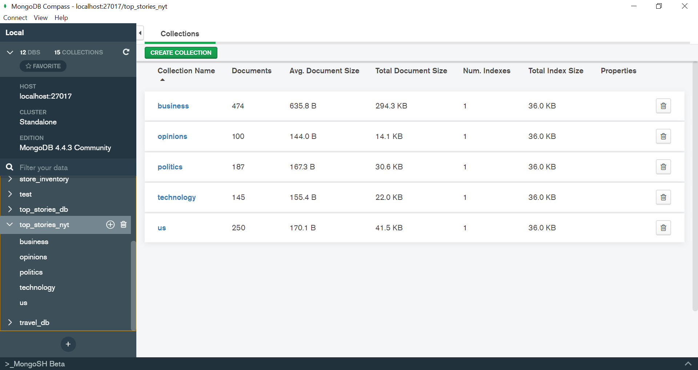
Top Stories API

Slide 10
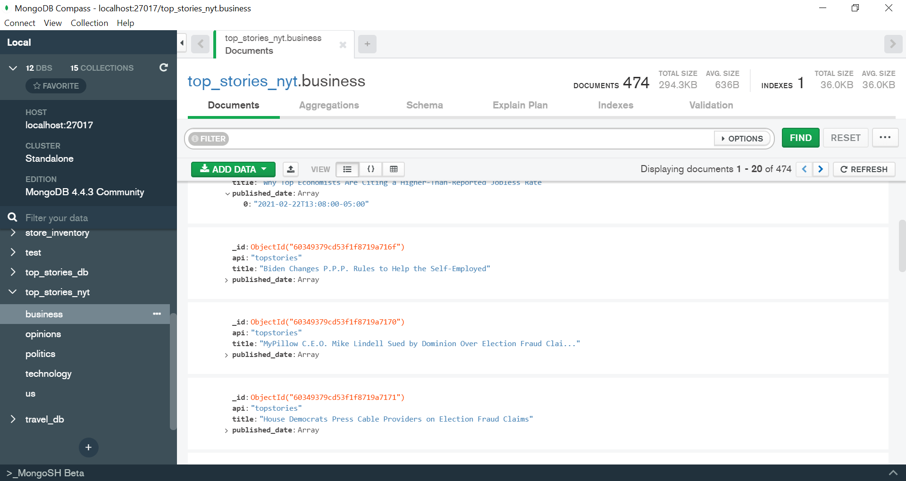
Top Stories API

Slide 11
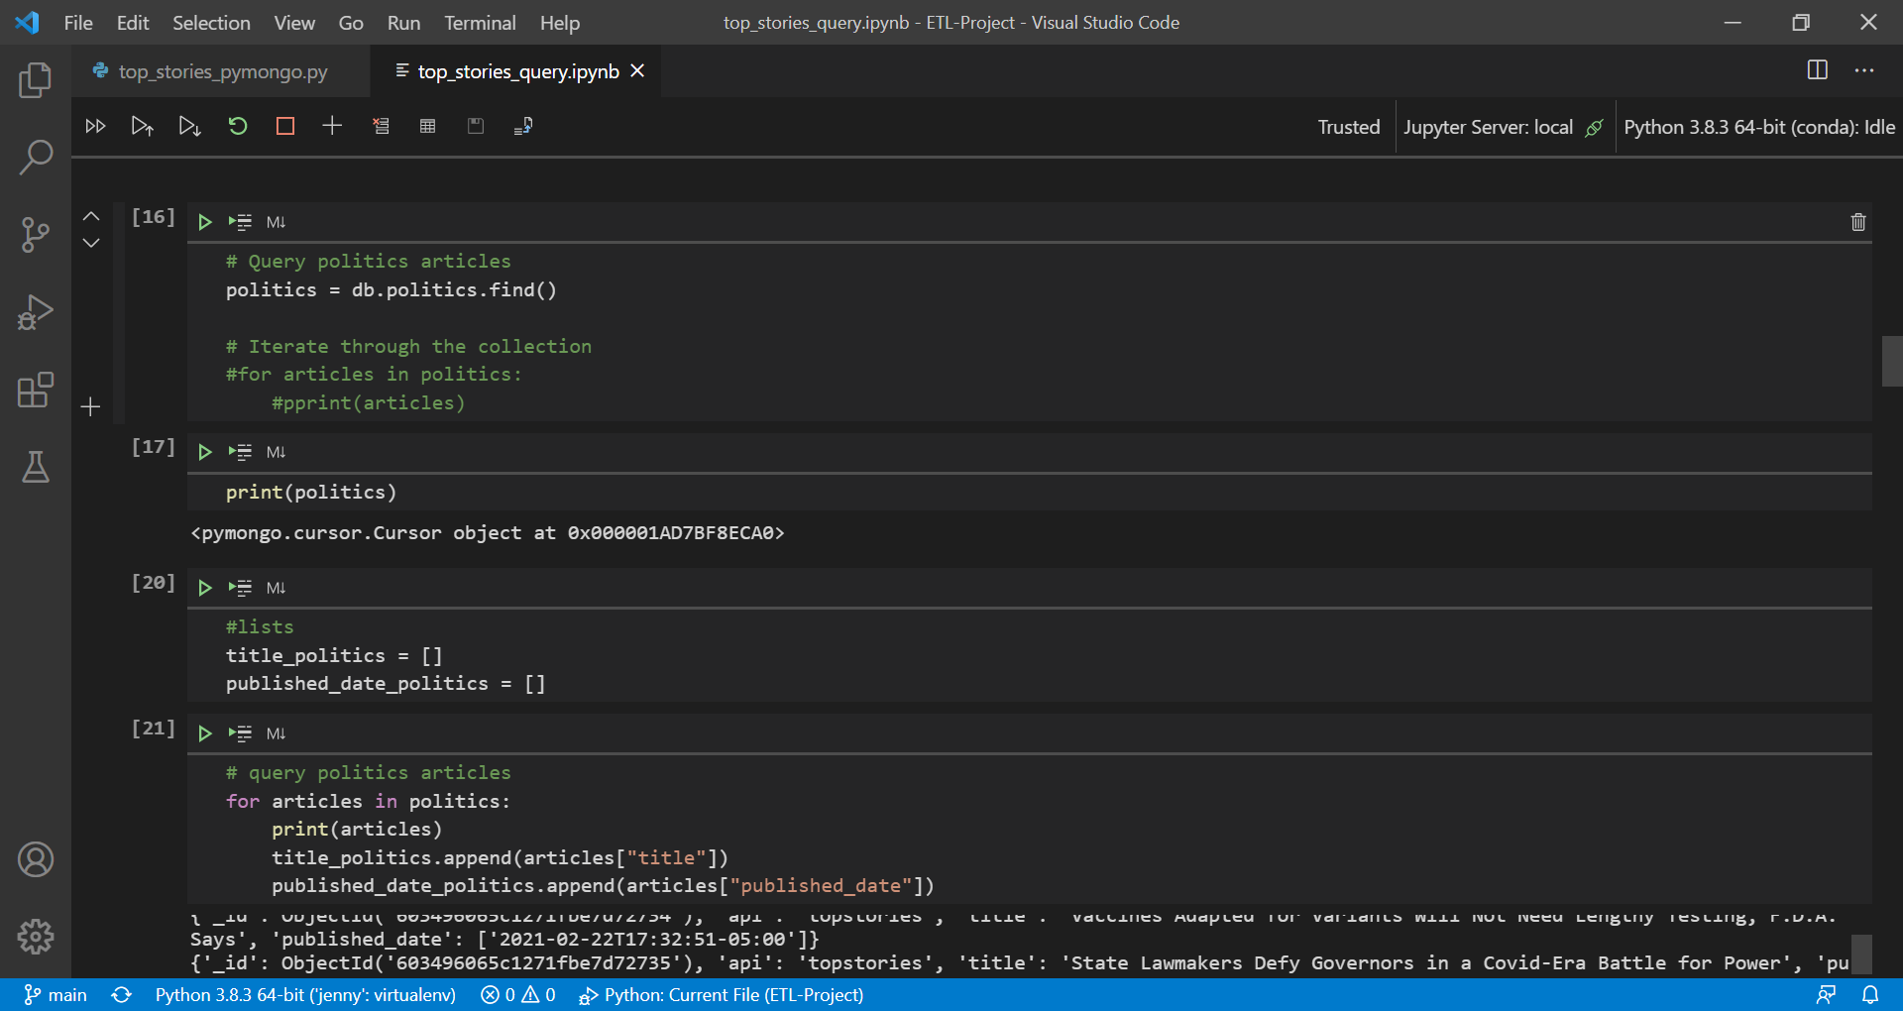
Top Stories API

Slide 12
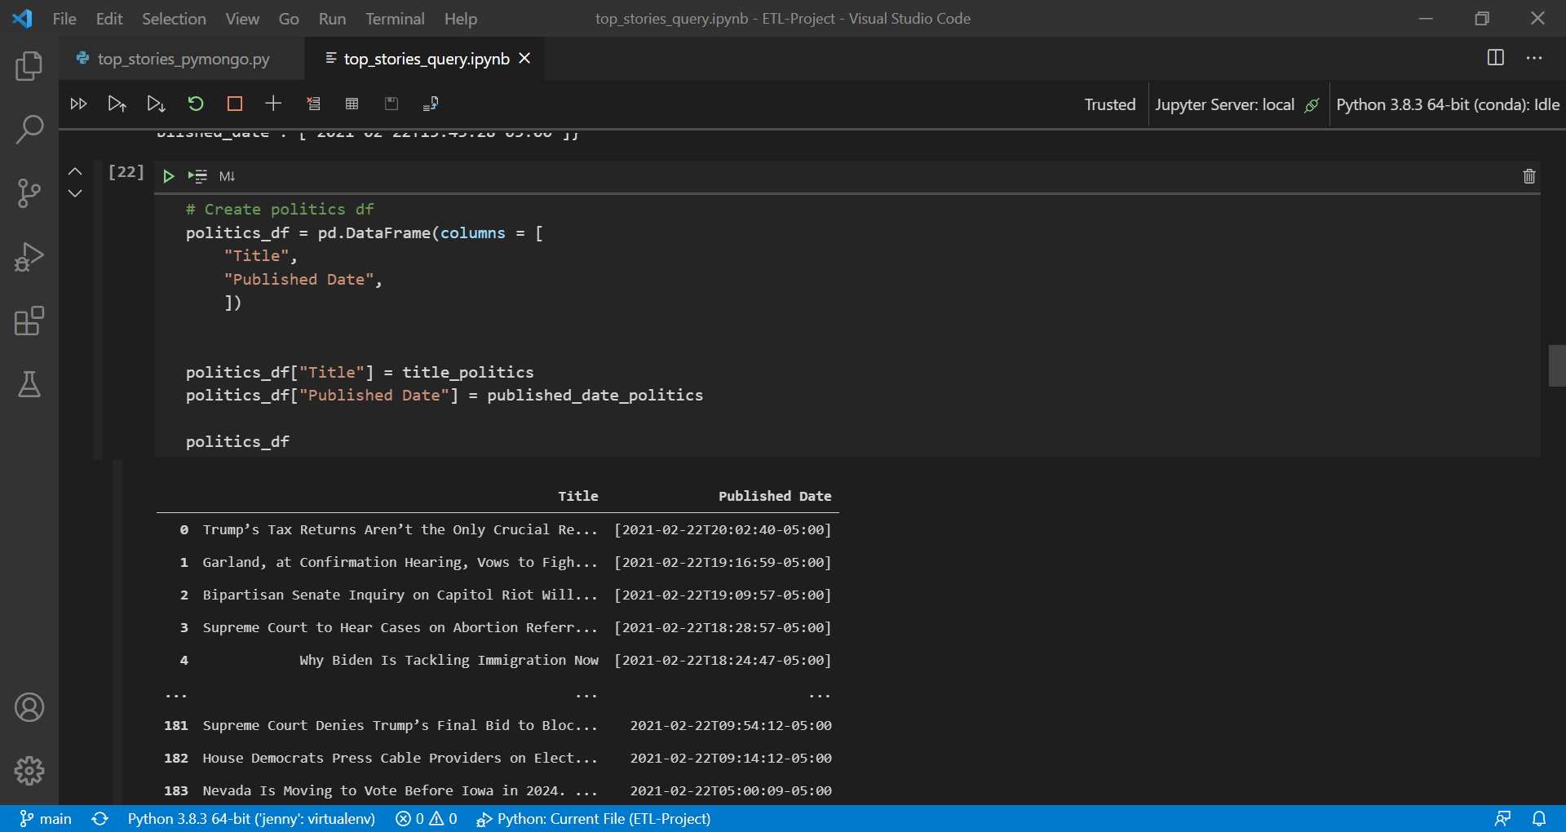
Top Stories API

Slide 13
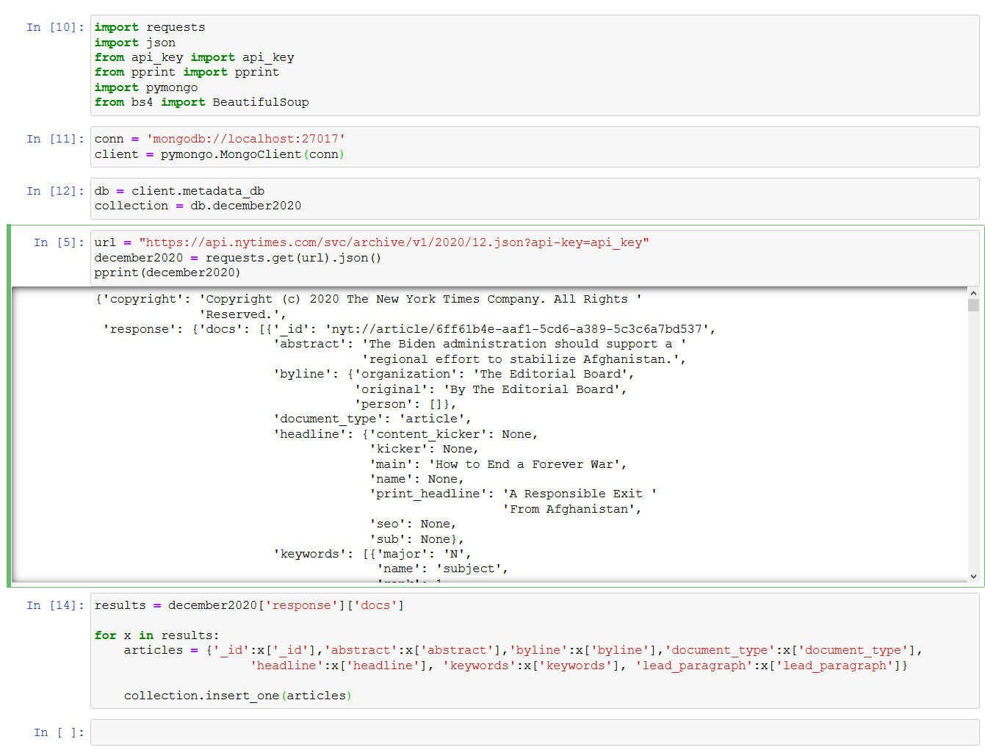
Archive API

Slide 14
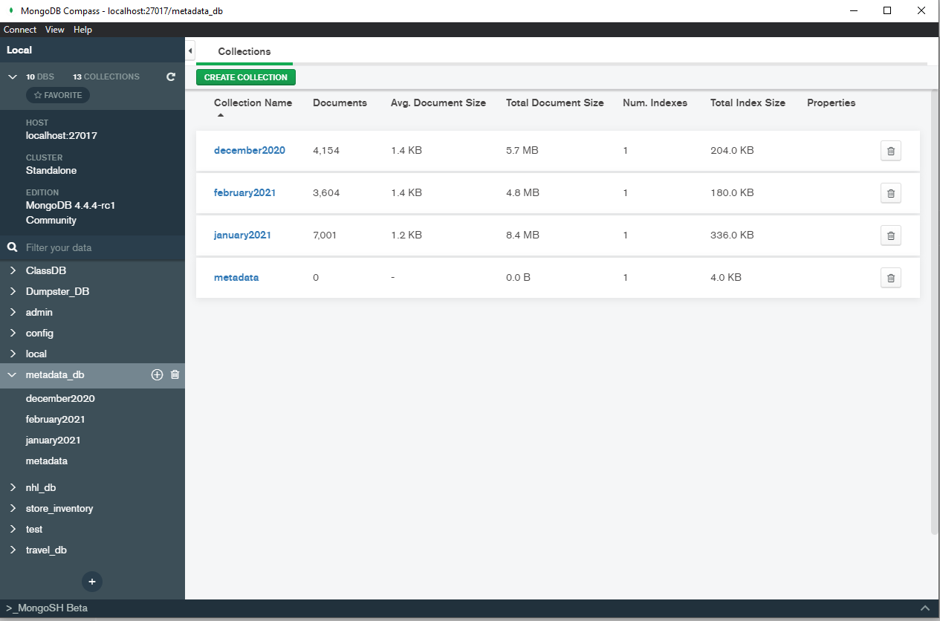
Archive API

Slide 15
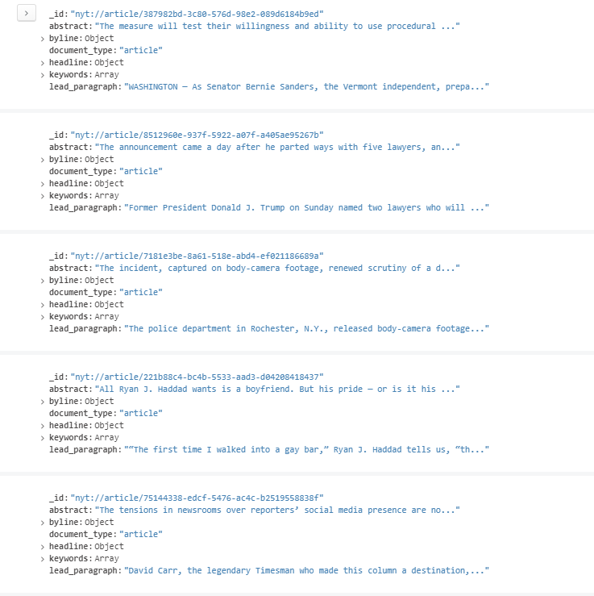
Archive API

Slide 16
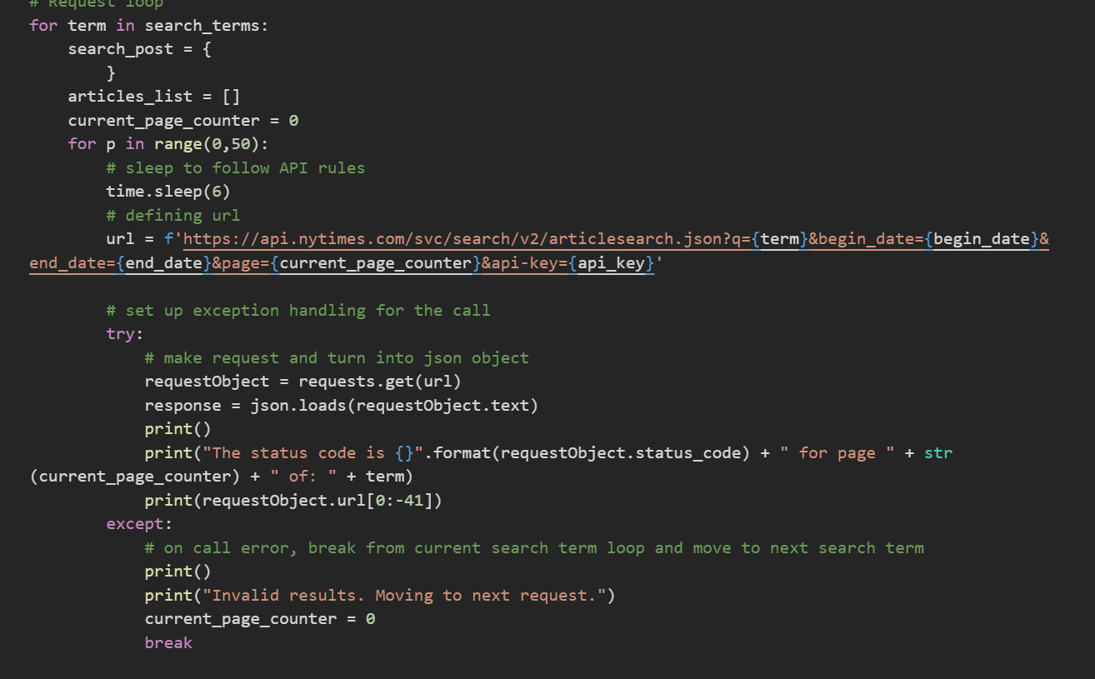
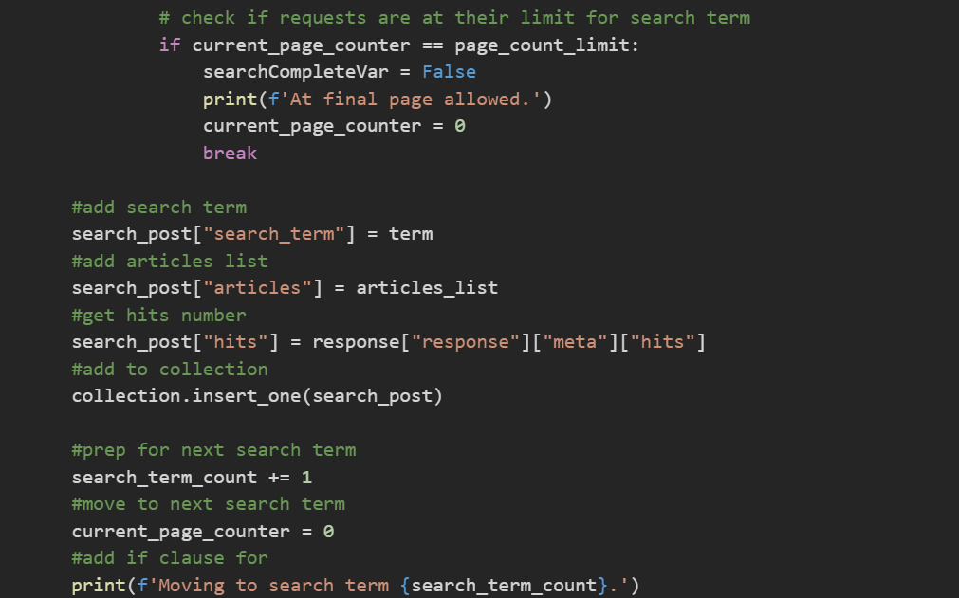
Article Search API - ETL 1

Slide 17
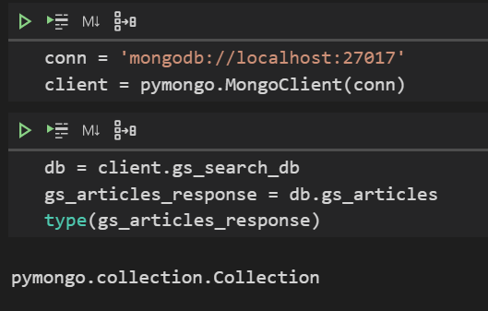
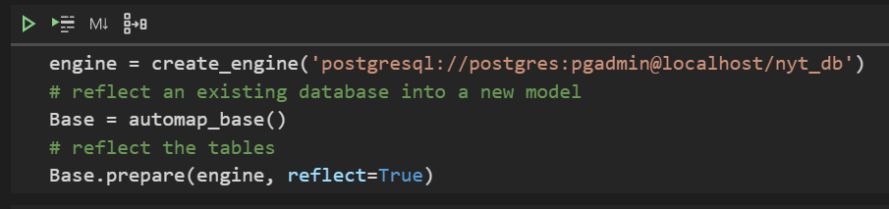
Article Search API - ETL 2

Slide 18
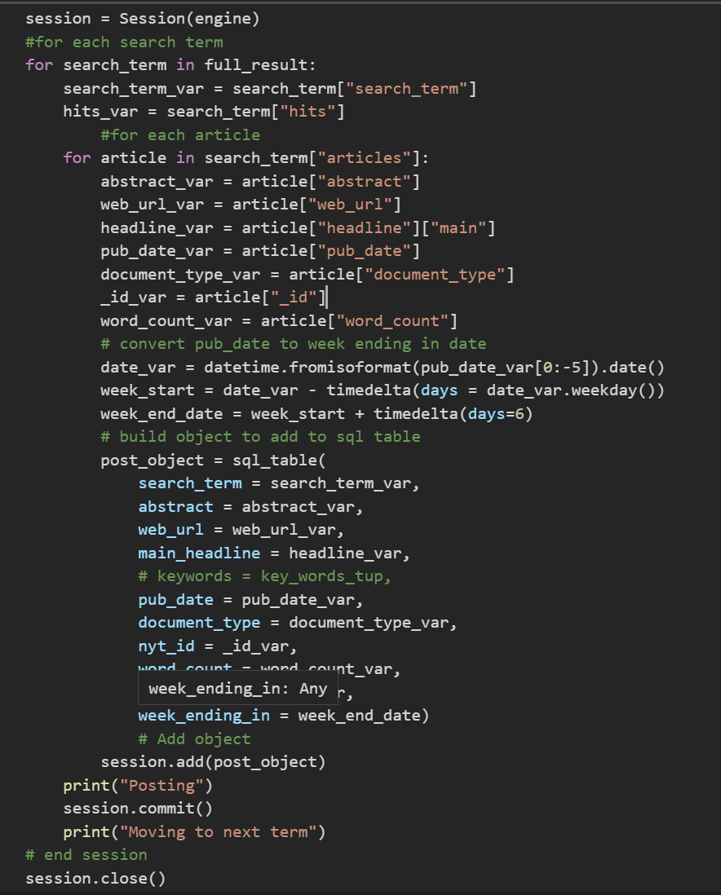

Slide 19
Other Topics
ETL in a broader operations environment
Operations over time

Slide 20
ETL in the Scope of a Broader Operations Environment
NY Times API
ETL 1
looping for search terms and retrieving JSON responses
MongoDB
(stores raw responses)
Query entire collection, targeting specific values within the MongoDB objects and append to SQL table
ETL 2
Analysis!
PostgreSQL
(storing analysis ready tables)
Processing analysis through counting, grouping, graphing etc.

Slide 21
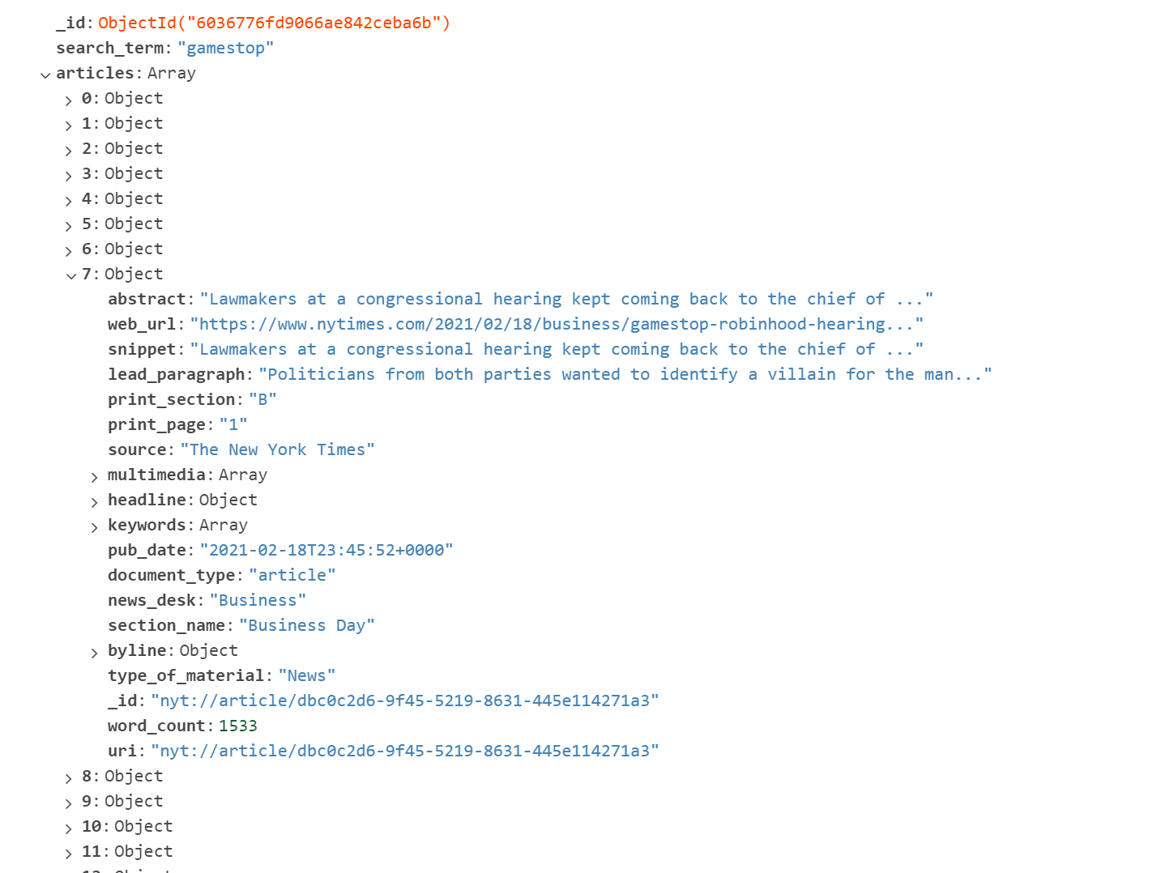
Archived Raw Response in MongoDB

Slide 22
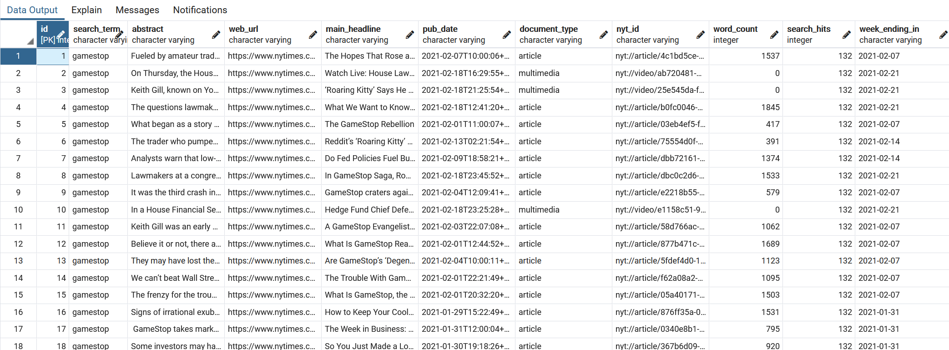
Analysis-Ready PostgreSQL Table

Slide 23
Operations Over Time
Ensure new data is added at intelligent intervals
Decisions on when to make new requests
e.g. Article Search API can set query dates. Ensure query dates are set on new weeks between calls
Updating MongoDB with update / appending to PostgreSQL with SQL Alchemy session add/commit
Small data sets can drop the data table and pull data for updated analysis

Slide 24
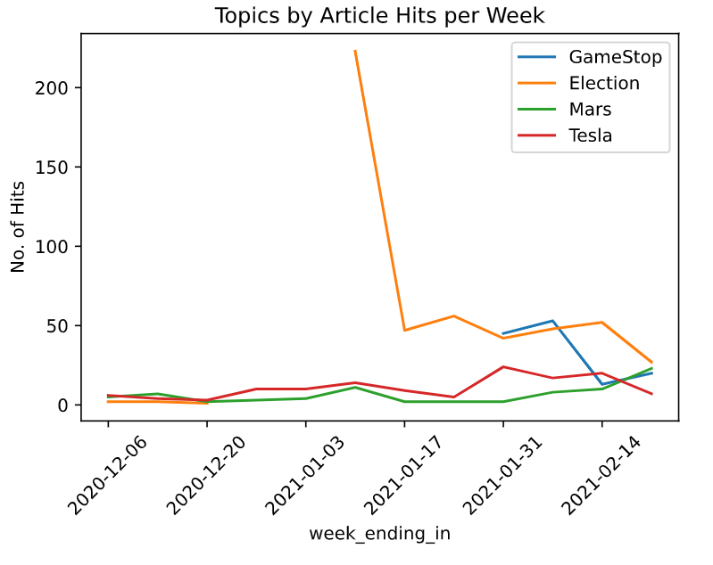
So… how is Gamestop hype doing right now?

Slide 25
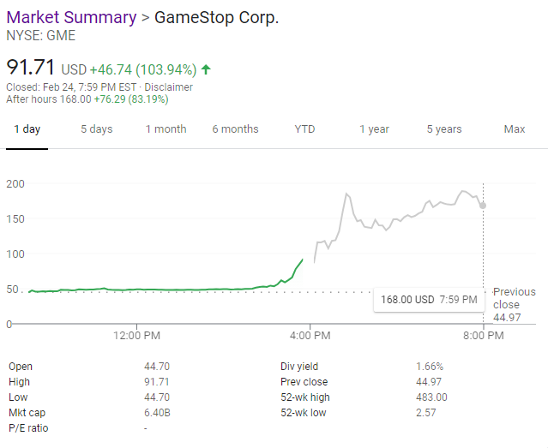

We like the stock.

